Slide 1
Chapter 4 Introduction to Network Layer

Slide 2
Outline
Introduction
Switching
Packet Switching at Network Layer
Network Layer Services
Other Network Layer Issues

Slide 3
4.1
Introduction
The McGraw-Hill Companies, Inc., 2000

Slide 4
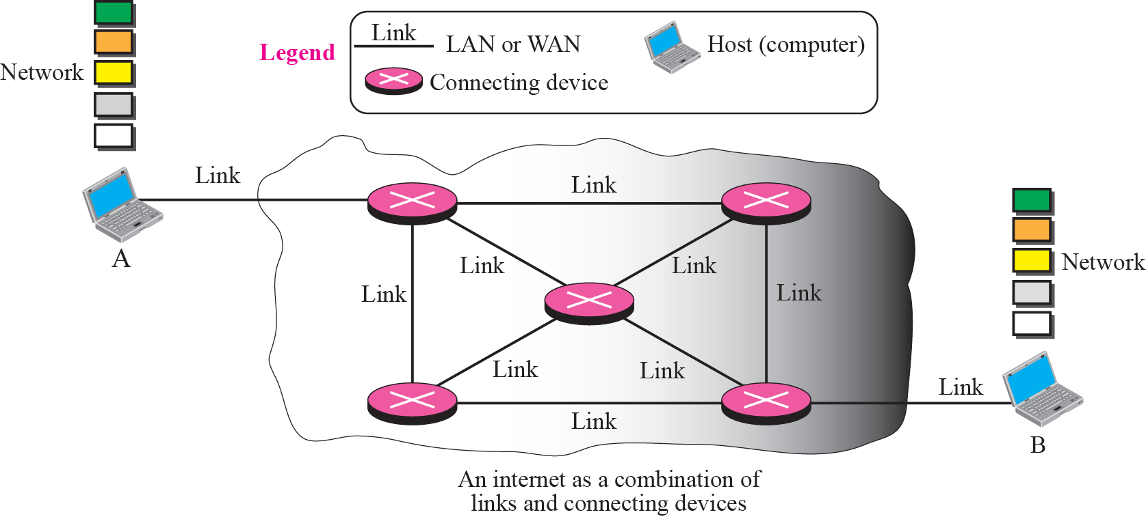
Internet as a Combination of LANs and WANs Connected Together
Switching occurs at each connecting device

Slide 5
4.2
Switching
The McGraw-Hill Companies, Inc., 2000

Slide 6
Local Area Network (LAN)
Switching
Connect one port to another port
Two methods
Circuit switching
Packet switching

Slide 7
Circuit Switching
Before the delivery of the message, a physical circuit is established between the source and destination
After the circuit is established
The entire message is transformed following this circuit
Example
Telephone systems

Slide 8
Packet Switching
A message from the upper layer is divided into packets and each packet is sent through the network
The network layer in Internet is a packet-switched network
In packet switching, two approaches to route the packets to the destination
The datagram approach: connectionless service
The virtual circuit approach: connection-oriented service

Slide 9
4.3
Packet Switching At
Network Layer
The McGraw-Hill Companies, Inc., 2000

Slide 10
Connectionless Service
The network layer in Internet adopt connectionless service
Why? Simple
Each packet is treated independently
Each packet has no relationship to any other packet belonging to the same message
The packet in a message may or may not travel the same path to destination
The router routes the packet based only on the destination network address

Slide 11
A Connectionless Packet-Switched Network

Slide 12
Forwarding Process in a Connectionless Network

Slide 13


Delay in a Connectionless Network

Slide 14
Connection-Oriented Service (Skip!)
There is a relation between all packets belonging to a message
Before all datagrams in a message can be sent
A virtual connection must be setup
All datagrams follows the same path
In addition to source and destination addresses
Each packet must contain a flow label, or a virtual circuit identifier that defines the virtual path the packet should follow

Slide 15
A Connection-Oriented Packet Switched Network (Skip!)

Slide 16
Connection-Oriented Service (Cont.) (Skip!)
Each packet is forwarded based on the label in the packet
Thus, why needs source and destination addresses?
Part of the path may still be using the connectionless service
The protocol at the network layer is designed with these addresses
It may take a while before they can be changed
Three-phase process is used to create a connection-oriented service
Setup, data transfer, and teardown

Slide 17
Forwarding Process in a Connection-oriented Network (Skip!)

Slide 18
Connection-Oriented Service: Setup Phase (Skip!)
Router creates an entry for a virtual circuit
Two auxiliary packets need to be exchanged: request packet and acknowledgment packet
Request packet (ref. the next slide)
A sends a request packet to B
R1 receives the packet.
Assume that the outgoing port is 3 (How to derive is shown in the future)
Create an entry in its table
Incoming port = 1,
Chooses an available incoming label = 14
Outgoing port = 3
R3 and R4 do the same work
B receives the request packet and assign a label = 77

Slide 19
Sending Request Packet in a Virtual-Circuit Network (Skip!)

Slide 20
Connection-Oriented Service: Setup Phase (Cont.) (Skip!)
Acknowledgement packet (ref. the next slide)
Destination sends an acknowledgement to R4
Add the label 77 into the outgoing label
R4 sends the acknowledgement to R3
Contain the incoming table 22
R3 and R1 perform the same work
A uses label 14 as the outgoing label to send data to B

Slide 21
Setup Acknowledgement in a Virtual-Circuit Network (Skip!)

Slide 22
Connection-Oriented Service: Data Transfer Phase (Skip!)
Data Transfer (ref. the next slide)
A uses label 14 to send packets
R1 changes the label to 66 and send to R3
R3 changes the label to 22 and send to R4
R4 changes the label to 77 and send to B
All packets in the message from the same sequence of labels and arrive in order at the destination

Slide 23
Flow of One Packet in an Established Virtual Circuit (Skip!)

Slide 24
Connection-Oriented Service: Tear Down Phase (Skip!)
Tear Down
A sends a special packet, called teardown packet
B responds with a confirmation packet
Then all routers delete the corresponding entry from their tables

Slide 25
Delay in a Connection-Oriented Network (Skip!)

Slide 26
4.4
Network Layer Services
The McGraw-Hill Companies, Inc., 2000

Slide 27
Network Layer Services
Logical addresses
Services provided at the source computer
Services provided at each router
Services provided at the destination computer

Slide 28
Logical addresses
Since network layer provide end-to-end communication
Two ends needs a universal identification system
Network-layer address or logical address

Slide 29
Services Provided at the Source Computer
Packetizing
Encapsulate the data from upper layer into a datagram by adding a header
Find the logical address of the next hop
Usually, the datagram may pass through many network
Need to consult a routing table to find the logical address of the next hop
Finding the physical (MAC) address of the next hop
The delivery is actually perform at the data link layer
Need MAC address to do the delivery
Need to map the next-hop logical address to the MAC address
Fragmenting datagram if necessary
Most LAN and WAN has a MTU (maximum transfer unit) limit
Fragment is needed if the datagram is larger than the MTU

Slide 30
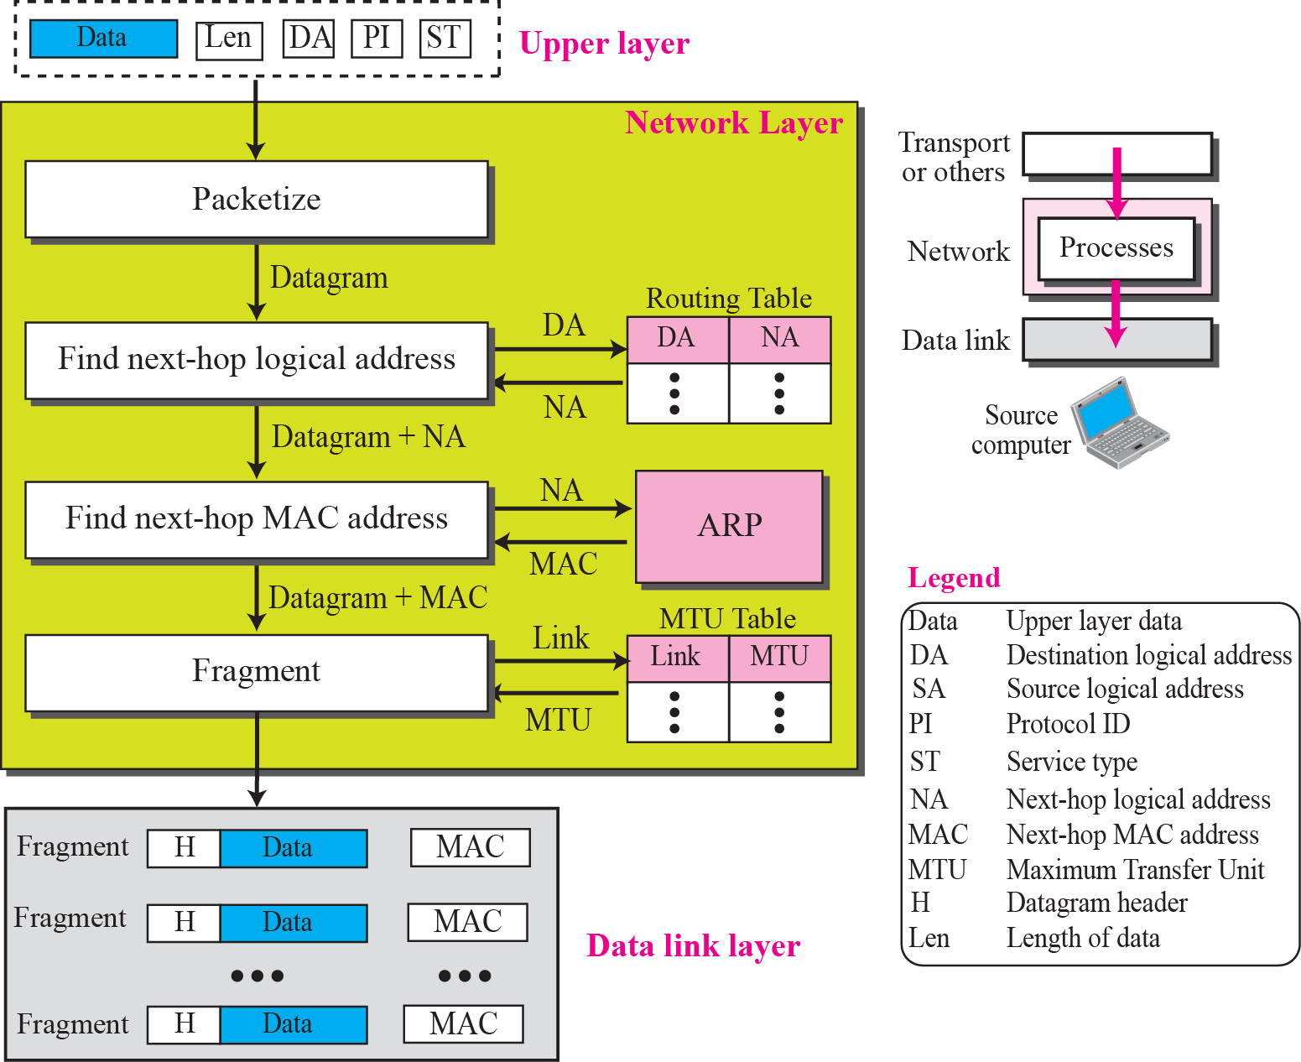
Services Provided at the Source Computer

Slide 31
Services Provided at Each Router
First, check the validity of the datagram using the checksum
Then, provides three services the same as the last three processes mentioned for a source
Find the logical address of the next hop
Finding the physical (MAC) address of the next hop
Fragmenting datagram if necessary

Slide 32
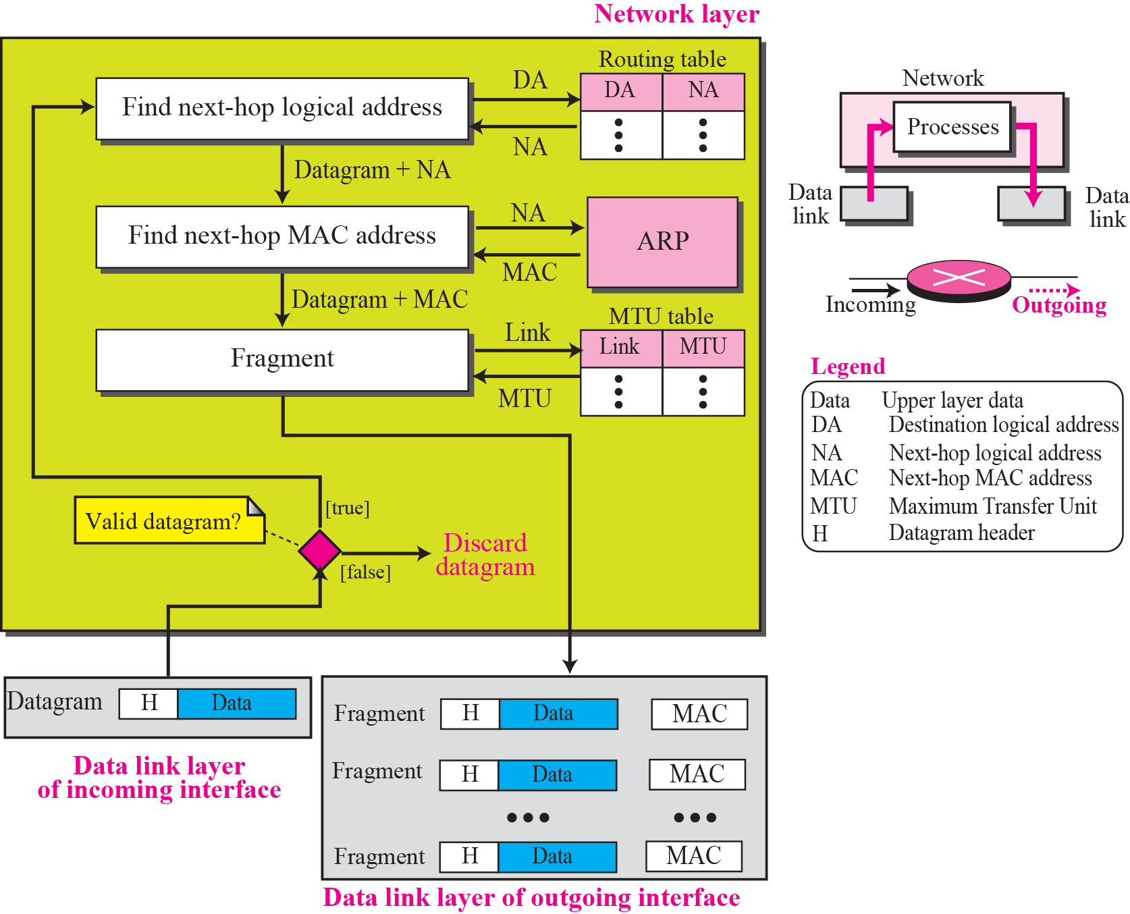
Processing at Each Router

Slide 33
Services Provided at the Destination Computer
De-packetize
Extract the data from each fragment
Assemble
Assemble the fragments

Slide 34
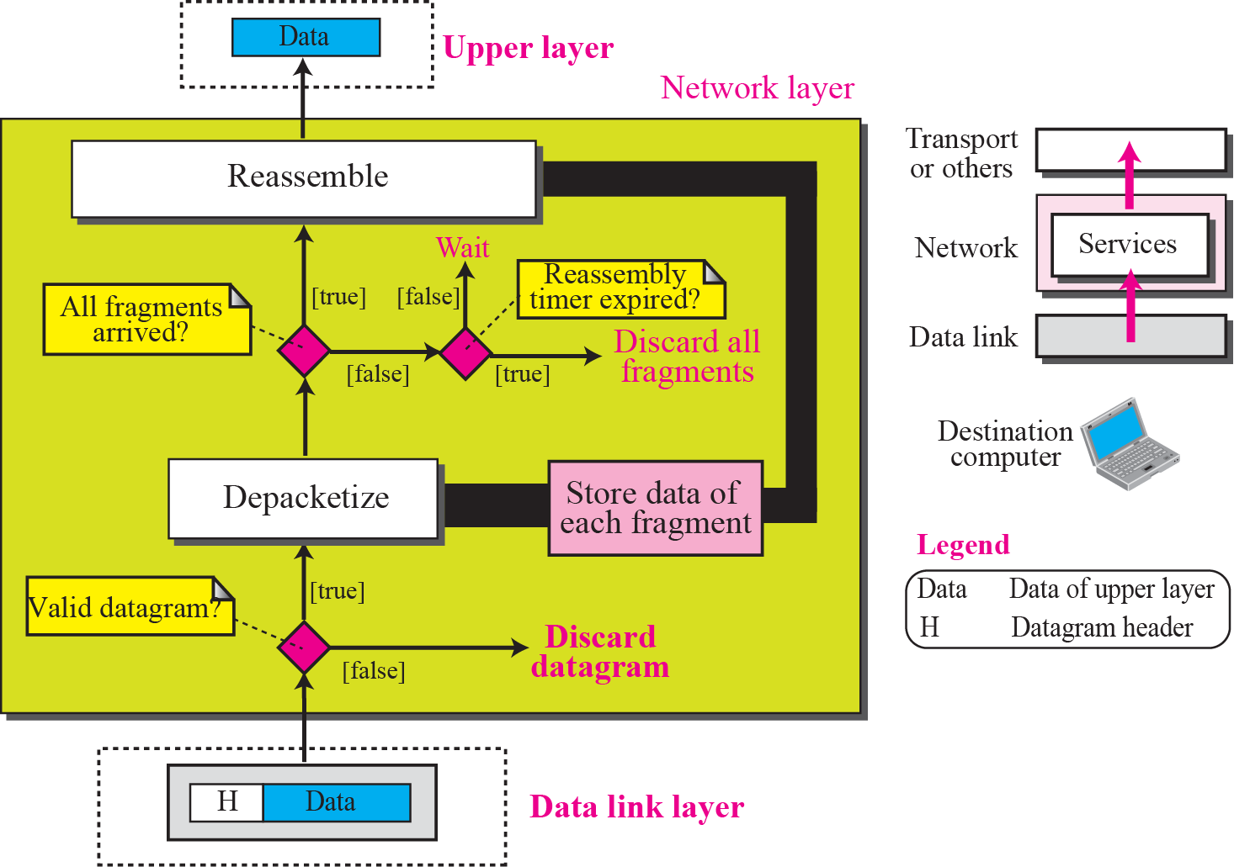
Processing at the Destination Computer

Slide 35
4.5
Other Network Layer
Issues
The McGraw-Hill Companies, Inc., 2000

Slide 36
Other Network Issues
Error control
Flow control
Congestion control
Quality of service
Routing
Security

Slide 37
Other Network Issues: Error Control
Error control:
Detect corrupted, lost, or duplicated datagrams
Correct errors after they have been detected
Questions:
Hop-to-hop error control is already implement at the data link layer
Why doe we need end-to-end error control at the network layer
Answers (ref. the next slide)
The data link layer can miss any error that occurs when the datagram is being processed by the router

Slide 38
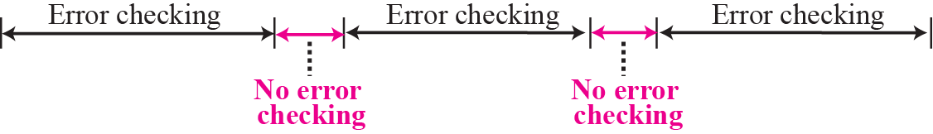
Error Checking at the Data Link Layer

Slide 39
Other Network Issues: Error Control (Cont.)
However, designers of the network layer wanted to make this layer simple and fast
If more rigorous error checking is needed, done at the upper layers
Thus, only checksum is used
But only apply to the header

Slide 40
Other Network Issues: Flow Control
Flow control
Regulate the amount of data a source can send without overwhelming the receiver
But, no flow control is used in network layer. Why?
Receiver may rarely be overwhelmed
Since the job of network layer at receiver is so simple
Does not need to perform error control in network layer
Upper layer can implement buffers
Flow control can be provided at upper layer protocol

Slide 41

Note
No flow control is provided for the current version of Internet network layer.

Slide 42
Other Network Issues: Congestion Control
Congestion
The number of datagrams are beyond the capacity of the network or routers
Some routers may drop some of the datagrams
Congestion control
Congestion control in a connectionless network
Congestion control in a connection-oriented network

Slide 43
Congestion Control in a Connectionless Network
Solutions:
Signaling
Set a bit in the datagram to inform the source
No used in the network layer
Choke packet:
A special packet can be sent from a router to the sender to inform the congestion
Adopted by ICMP
Ranking
Rank the packets by their importance in the whole message
Drops packets that are less important when congested

Slide 44
Congestion Control in a Connection-Oriented Network (Skip!)
Two Methods:
Creates an extra virtual circuit when there is a congestion
Advanced Negotiation
A level of traffic is negotiated and granted if feasible when the virtual circuit is setup
Better solution

Slide 45
Other Network Issues (Cont.)
Quality of Service
For multimedia communication
Routing
How to create routing table or a virtual circuit
By routing protocols
Make routing table, maintain them, and update them
Security
IPSec

